Slide 1
INTRODUCING GENDERISE'S GENDER, CLIMATE, AND ARTIFICIAL INTELLIGENCE PROGRAM
An overview of GENDERISE's innovative program that leverages AI and gender-responsive approaches to address the intersection of gender and climate change.

Slide 2
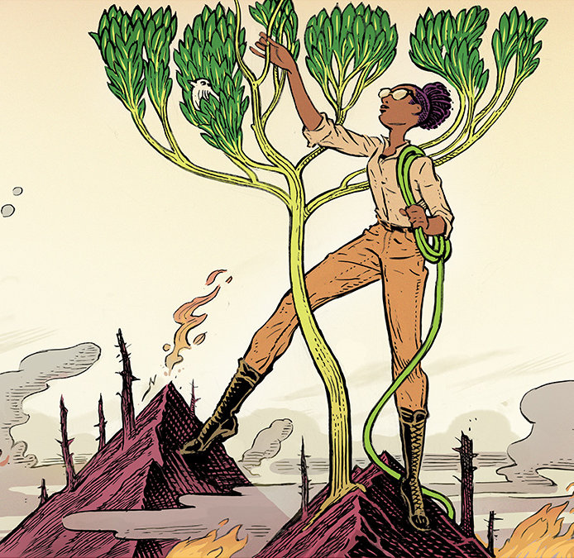
With this new initiative, GENDERISE, aims to explore the critical intersection between gender, climate change, and artificial intelligence. By examining the complex interplay between these crucial domains, the program seeks to uncover important insights and drive impactful change.

Slide 3
INTRODUCTION
Program's Mission
Importance of the Issue
Collaborative Approach
To address the critical intersection of gender, climate change, and artificial intelligence, and promote inclusive and equitable solutions.
Climate change disproportionately affects women and marginalized communities, and AI systems can perpetuate gender biases if not designed inclusively.
Bringing together experts from diverse backgrounds to develop interdisciplinary strategies and foster cross-sector partnerships.
By addressing the complex interplay of gender, climate, and AI, this program aims to drive transformative change and create a more sustainable and equitable future for all.

Slide 4
THE CLIMATE CHALLENGE
The Disproportionate Impact on the Global South
Climate change poses the greatest threat to countries in the Global South, where communities often lack the resources and infrastructure to adapt. This region is experiencing more severe weather events, rising sea levels, and other climate-related challenges that exacerbate existing vulnerabilities.
The Gender Dimension of Climate Change
Women in the Global South are disproportionately affected by climate change, as they often bear the primary responsibility for securing food, water, and energy for their households. Climate-related disasters can disrupt these essential resources, leading to increased workloads, health risks, and economic hardships for women.
Barriers to Resilience and Adaptation
Socioeconomic and cultural barriers, such as limited access to education, financial resources, and decision-making power, can hinder women's ability to adapt to the impacts of climate change. This further exacerbates the gender disparities in climate change impacts.
Promoting Gender-Responsive Climate Action
Addressing the gender dimensions of climate change is crucial for developing effective and equitable solutions. This involves integrating gender considerations into climate change policies, programs, and decision-making processes to ensure that the unique needs and experiences of women are addressed.

Slide 5
THE POWER OF AI
Revolutionizing Climate Action
AI for Climate Resilience
Gender-Responsive AI Solutions
Explore the incredible potential of AI to transform the way we address climate change, driving innovative solutions and catalyzing impactful climate action.
Discover how AI-powered applications can enhance climate resilience, from predictive modeling to early warning systems and disaster response optimization.
Understand the critical need for gender-responsive AI solutions that consider the unique challenges and perspectives of women and marginalized communities in the face of climate change.
Empowering Women in Climate Tech
Collaborative Opportunities
Explore initiatives that empower women to lead the development and implementation of AI-driven climate solutions, fostering a more inclusive and equitable climate action landscape.
Identify collaborative opportunities between GENDERISE's Gender, Climate, and Artificial Intelligence Program and stakeholders to leverage the power of AI for gender-responsive climate action.

Slide 6
ADDRESSING GENDER DATA GAPS
Why Gender-Disaggregated Data Matters
GENDERISE's Data Collection Approach
Data Analysis and Insights
Incorporating Gender Perspectives
Explains the importance of collecting data that is broken down by gender, as this allows for a more nuanced understanding of how climate change impacts people of different genders. This data can lead to more targeted and effective climate interventions.
We plan to systematically collect gender-disaggregated data through surveys, interviews, and other research methods. This includes ensuring that data collection teams are gender-balanced and that questions are designed to capture gender-specific experiences and needs.
GENDERISE will analyze the collected gender-disaggregated data to identify patterns, trends, and gender-specific vulnerabilities. This information will be used to inform the design and implementation of climate interventions that address the unique needs of people of different genders.
GENDERISE will support the incorporation of insights gained from gender-disaggregated data into climate change programs and policies.

Slide 7
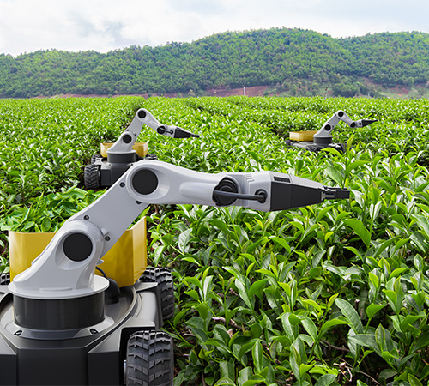
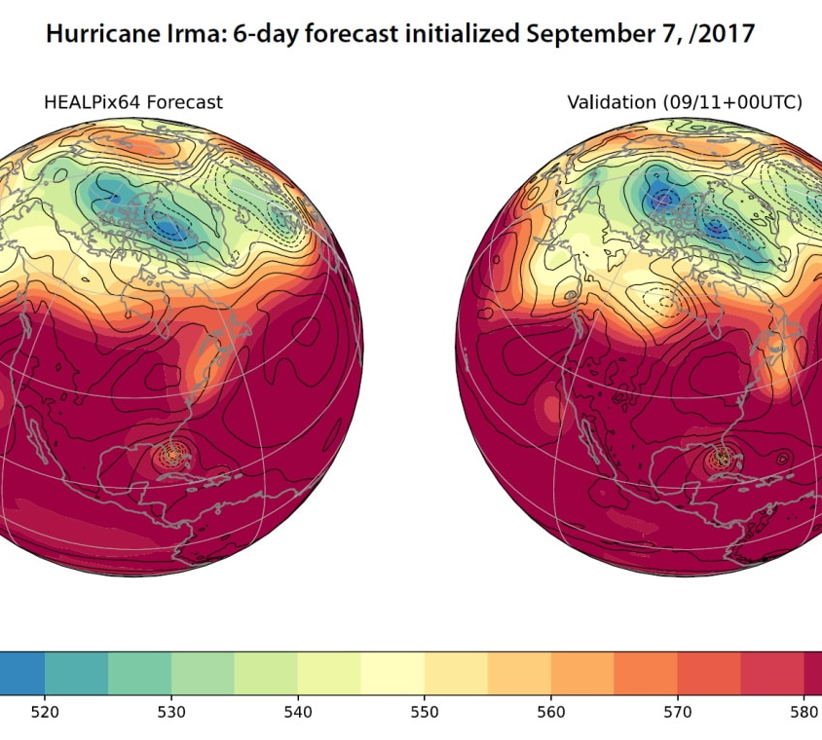
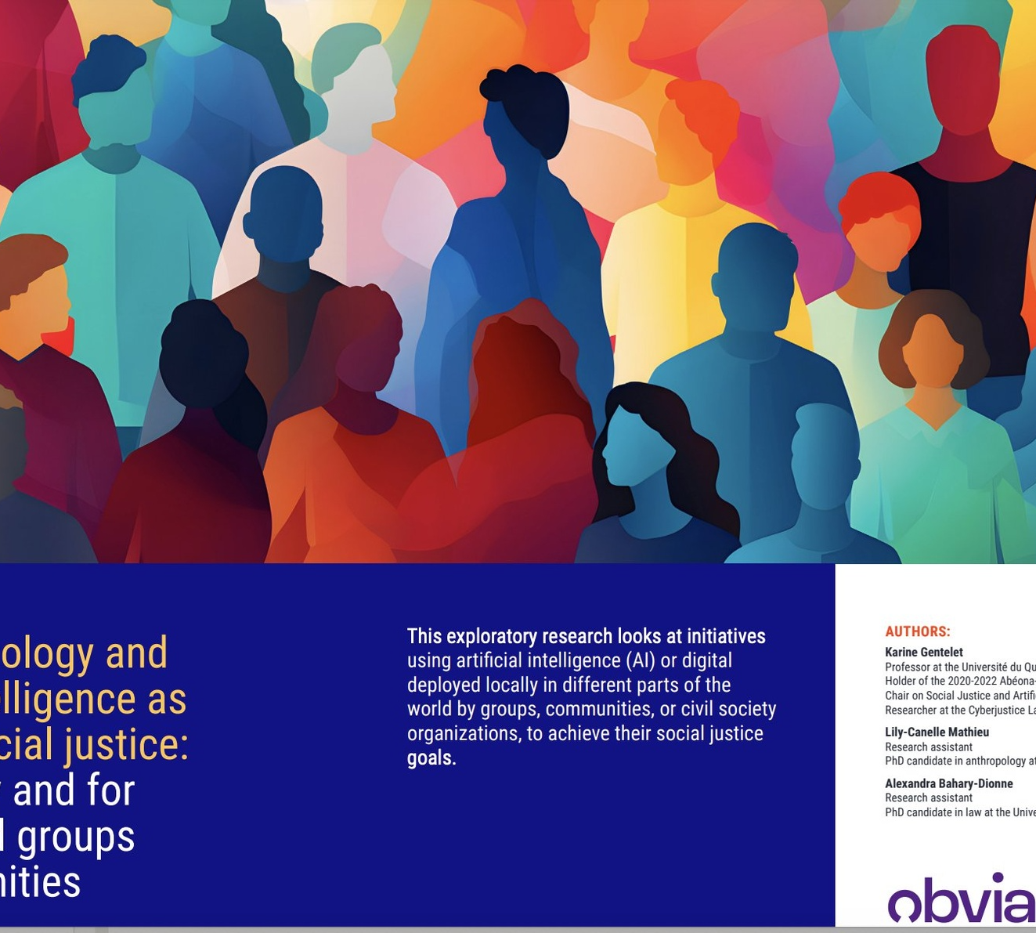
PRACTICAL APPLICATIONS
AI-Powered Crop Monitoring
Predicting Extreme Weather Events
Promoting Women Economic Empowerment
Inclusive AI for Marginalized Communities
Farmers can use an AI-powered app to monitor their crops and detect early signs of disease, allowing for more effective and sustainable farming practices.
AI-generated forecasts of extreme weather events, such as hurricanes and heatwaves helps communities prepare and build resilience against the impacts of climate change.
Women can use AI-powered platforms to access business resources, financing, and mentorship, overcoming barriers and inequalities faced by women in the workforce.
A diverse group of community members are collaborating with GENDERISE to develop AI-powered tools that address the unique needs and challenges faced by marginalized communities, promoting social and environmental justice.

Slide 8
JOIN US
Collaborate with researchers
Partner with practitioners
Seek funding opportunities
We invite researchers to join our interdisciplinary team and contribute their expertise to our mission
We want to engage with practitioners in the field of gender, climate, and AI to inform our work and share insights
We invite funders to support our initiatives and help drive impactful change in these critical areas
Join our mission and be part of the transformative work we're doing at the intersection of gender, climate, and artificial intelligence.

Slide 9
THANK YOU
We hope this presentation has provided you with valuable insights into GENDERISE's Gender, Climate, and Artificial Intelligence Program.
If you have any further questions or would like additional information, please don't hesitate to reach out to us at info@genderise.org.

